Slide 1
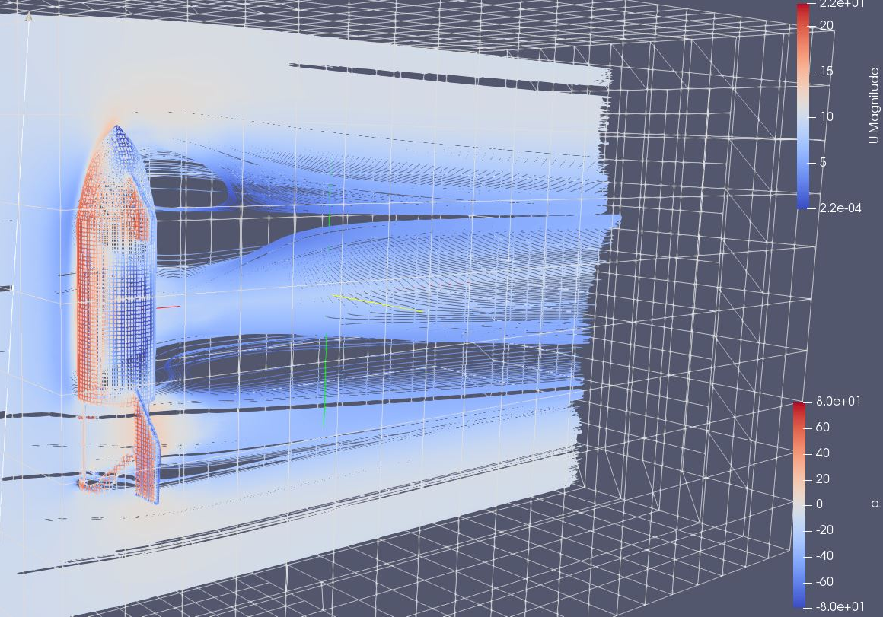


Introduction to OpenFOAM CFD with WSL and Simflow
Servaas Clerckx

Slide 2
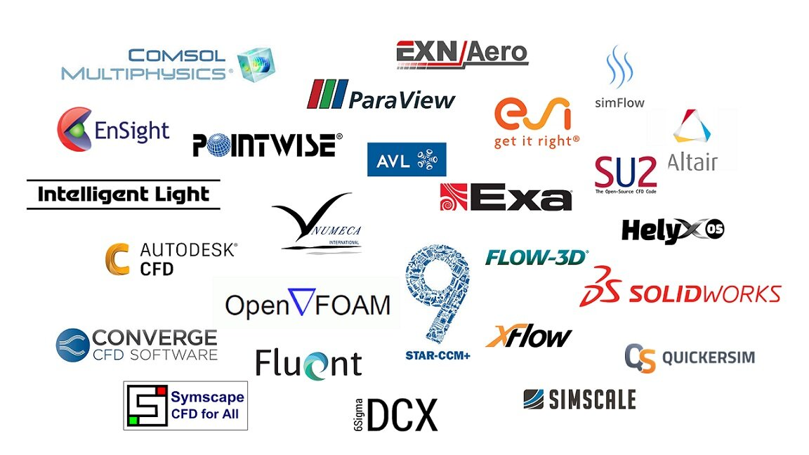



So, you want to CFD?
09-10-2020

Slide 3
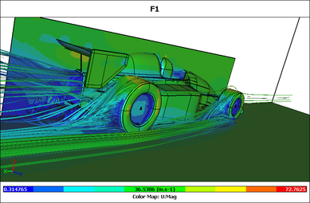
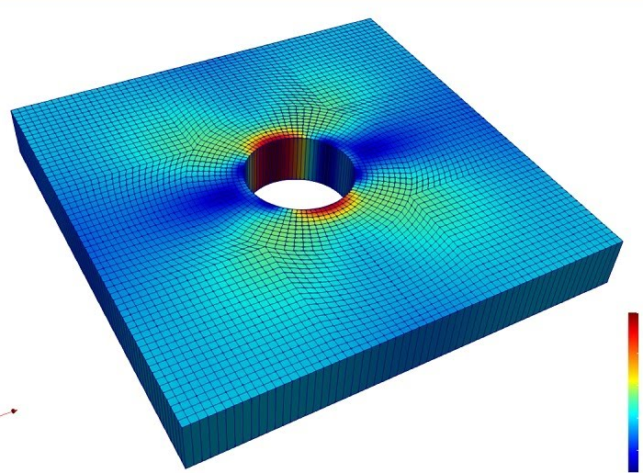
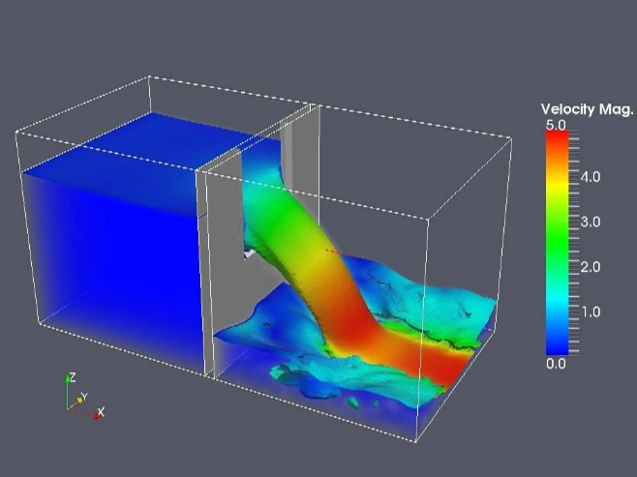
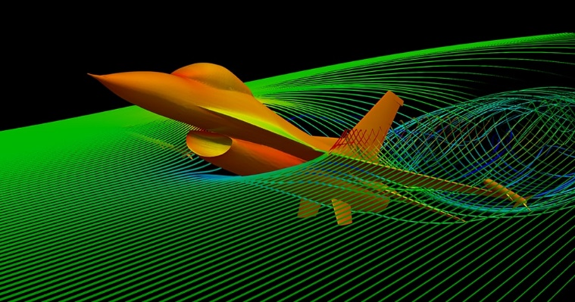

What is ?
Wikipedia: OpenFOAM is a free, open-source C++ toolbox for the development of customized numerical solvers of continuum mechanics problems.
09-10-2020
Notes:
Not limited to CFD but for anything continuous
Water, Air, Stress, Temperature
OpenFOAM is extremely powerful and infinitely customizable

Slide 4

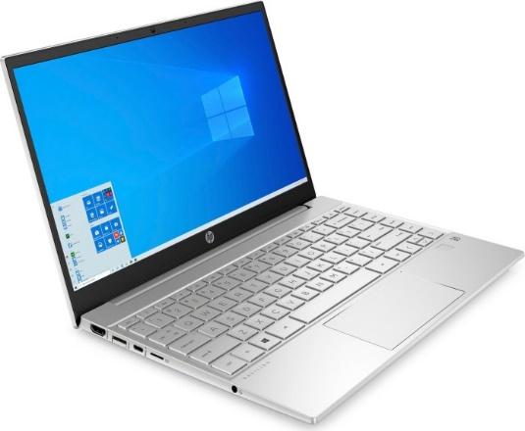
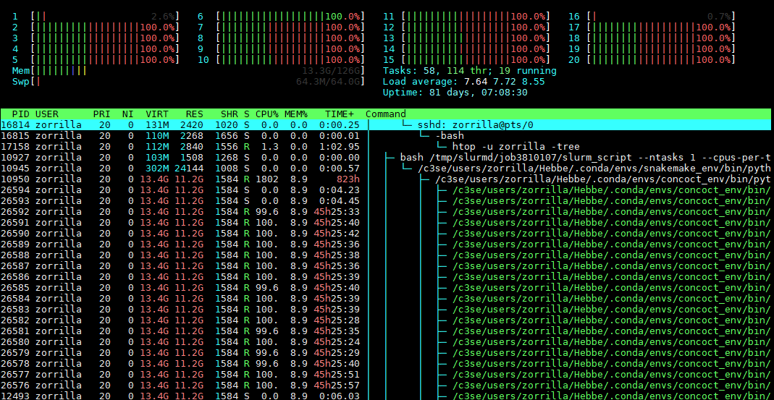
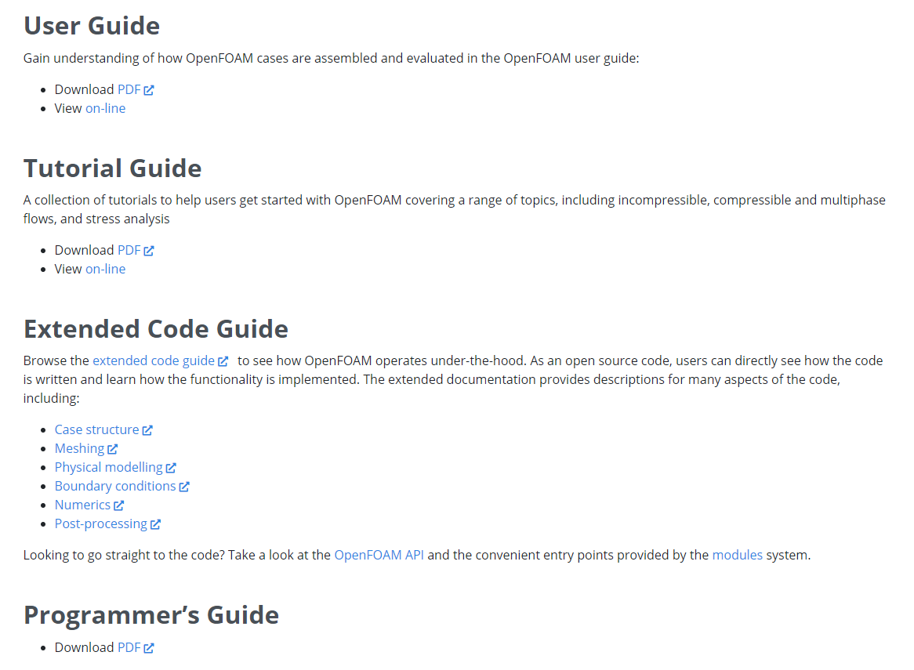
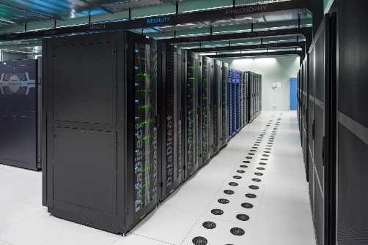

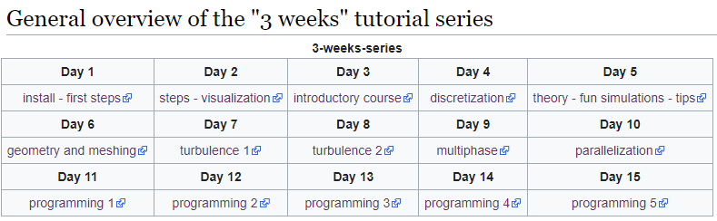



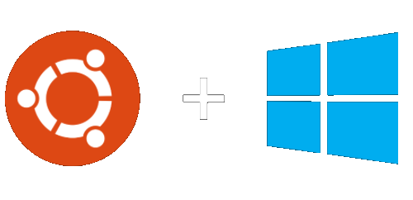
The problem
Academic Ecosystem
Student Ecosystem
[169 pages]
[104 pages]
[60 pages]
09-10-2020
Notes:
But that brings it’s own drawbacks: Openfoam is mostly made by academics or industy for academics or industry (which means people who know what they are doing). This results in the introductory tutorial series online being a three week long course or the introductory openfoam user guide to be a combined 300 pages. This is then all run in a linux ecosystem on high performance clusters. Contrast this with the typical student ecosystem which is Windows, a laptop and way too much time pressure. This is the core problem that I want to address in this workshop. I will present a bridge between these two ecosystems that allows you to get easily get your hands dirty with OpenFOAM but also leaves the door open to progress into the advanced stuff.

Slide 5
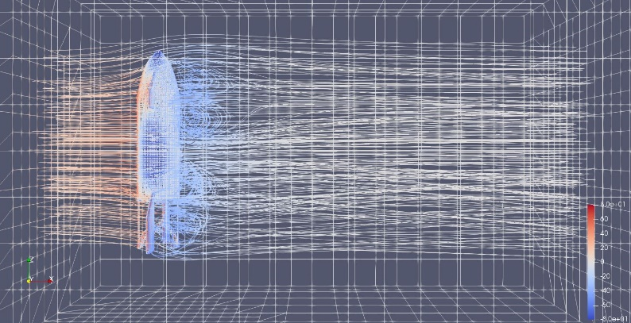
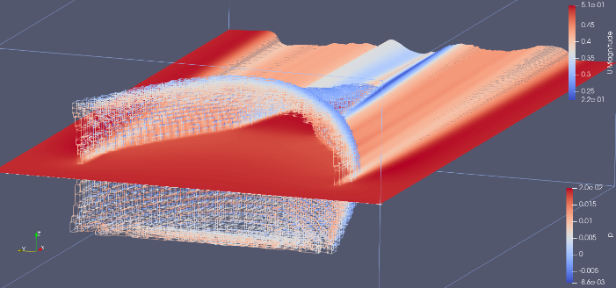
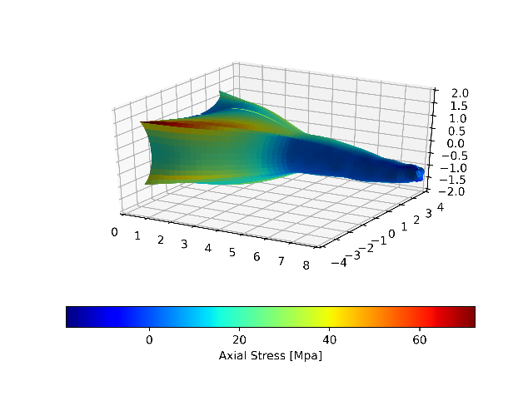


Workshop overview
Quick CFD and FVM introduction
Getting your hands dirty in CFD with
Ubuntu crash course (WSL)
Running your own simulations in WSL
(Optional) Advanced topics in OpenFOAM CFD
Programming OpenFOAM applications using VS Code
Recompiling OpenFOAM source in WSL

Slide 6
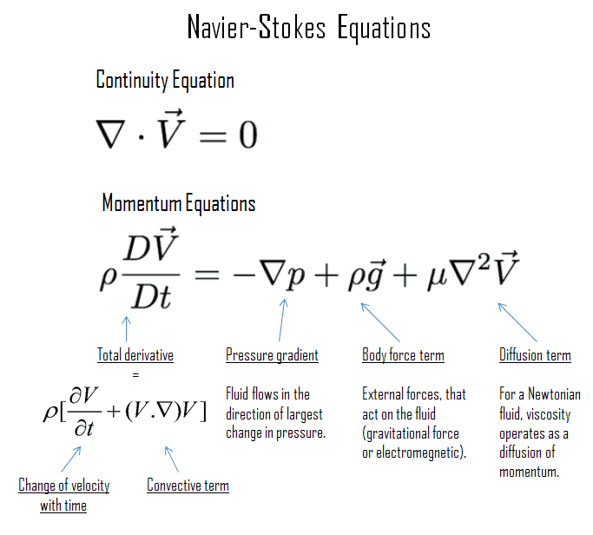
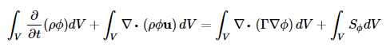
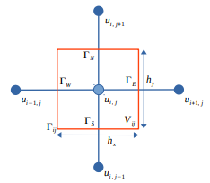
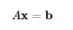
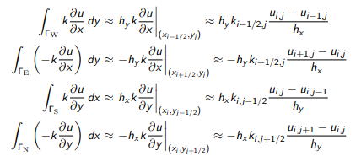
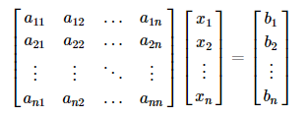
Computational Fluid Dynamics
Finite Volume Method
Discretization
Linear Algebra

Slide 7
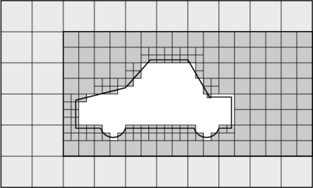
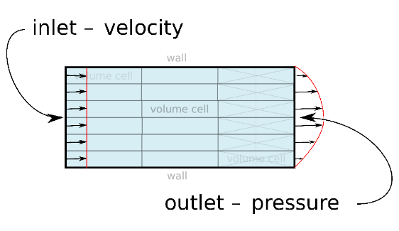
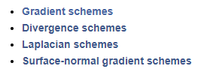
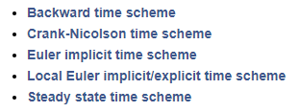
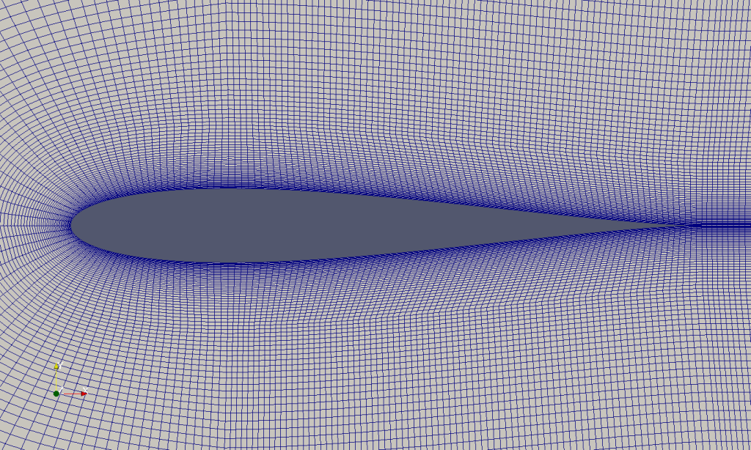
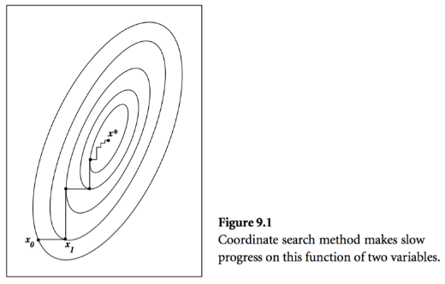
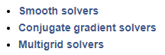
CFD practical matters
Discretization: Derivatives and Integration
(Numerical Schemes)
Discretization: Time and Boundary Conditions
Discretization: Meshes
Solution: Solvers and Linear Algebra
Computer Science: Algorithm Performance
Computer Science: Parallelization

Slide 8
CFD simulation practical matters: Discretization
Discretization: Derivatives and Integration
(Numerical Schemes)
Discretization: Time and Boundary Conditions
Discretization: Meshes
Artificial Diffusion
Conservation of Variables
Stability
Stability
Validity
Bad mesh in = bad results out
Solution: Solvers and Linear Algebra
Stability
Robustness
Computational time
Computer Science: Algorithm Performance
Computer Science: Parallelization
Notes:
If not familiar with these terms, that’s okay, this is a general introduction to give you a feel for what is going on and where the possible pitfalls are when doing your own simulations

Slide 9
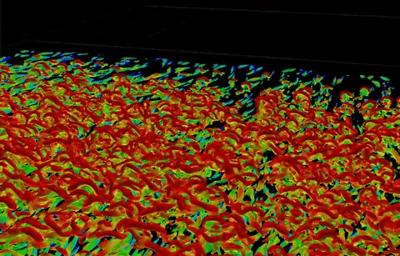
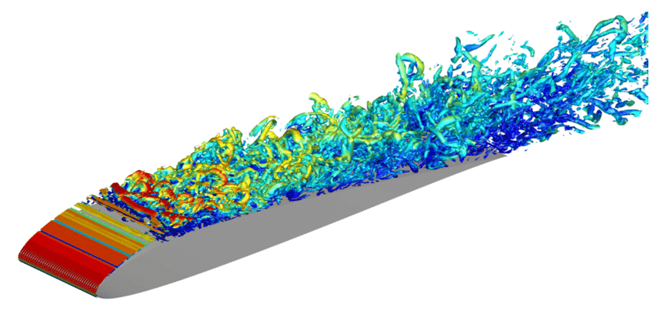


CFD simulation problem: What is turbulence?
Notes:
Length scales
Interested in large scale but small scale is very relevant

Slide 10


More computational power?
Notes:
“If brute force isn’t working, you’re not using enough force”
Video game reference

Slide 11
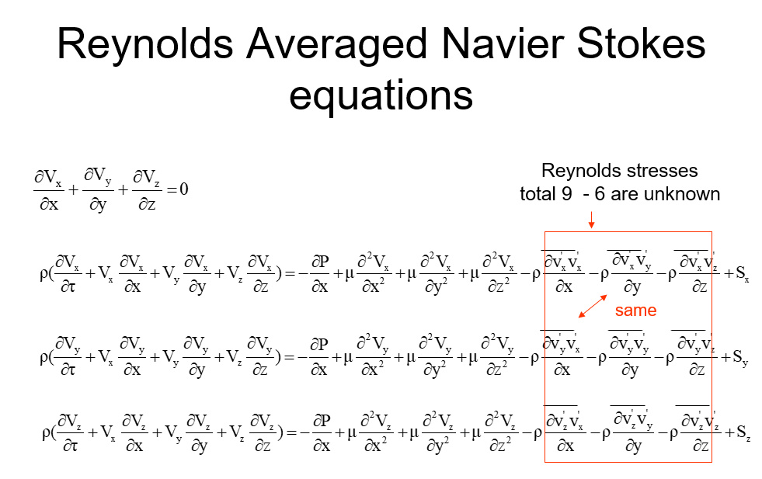
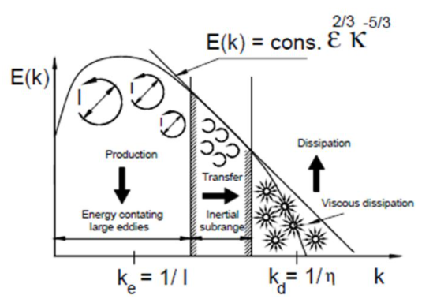
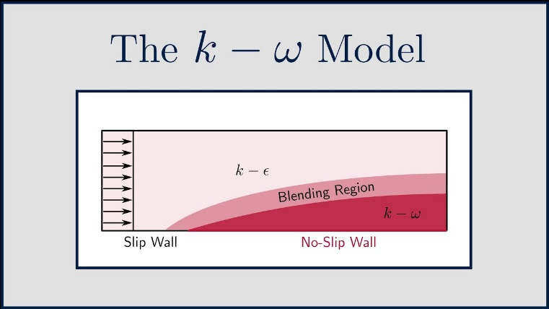
CFD simulation approaches: The two models
Reynolds Averaged Navier Stokes
(RANS)
Large Eddy Simulation (LES)
“Big whirls have little whirls, That feed on their velocity; And little whirls have lesser whirls, And so on to viscosity.”
― Lewis Fry Richardson

Slide 12
SimFlow demonstration
Install link: https://sim-flow.com/download-simflow/

Slide 13
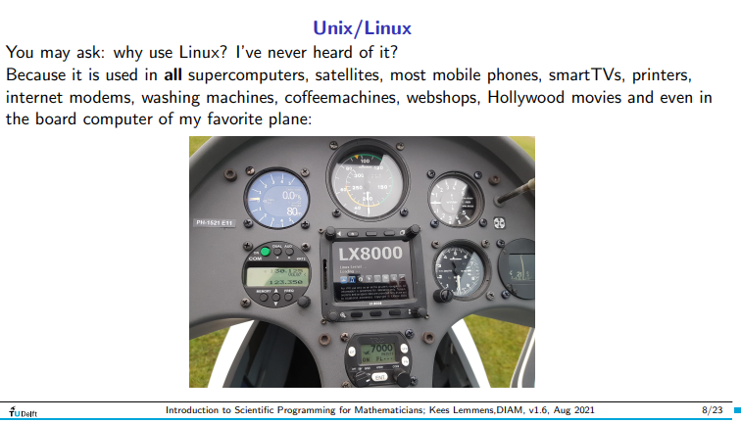


Linux/ Ubuntu what is it?

Slide 14
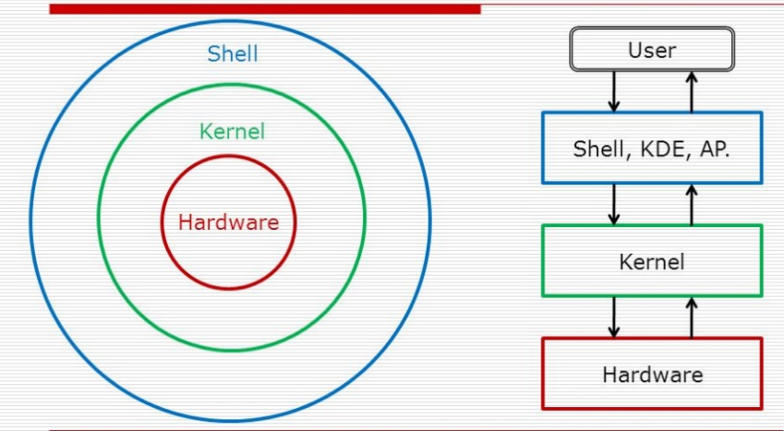

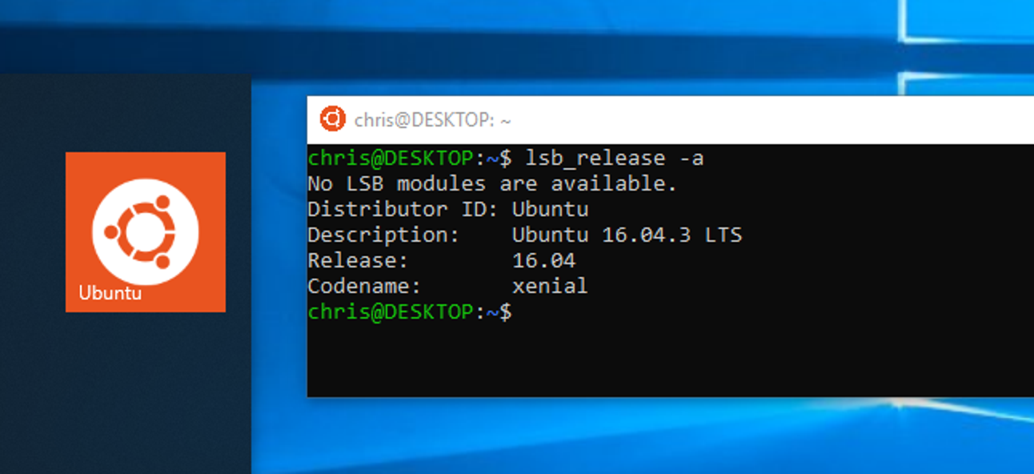

Ubuntu crash course: Windows Subsystem for Linux
Notes:
The Ubuntu shell is the main thing you’ll be working with → Bash → Way of interacting with your ‘computer’ (kernel) in a Pythonic way
If curious about Linux, dive into it, it’s awesome.

Slide 15
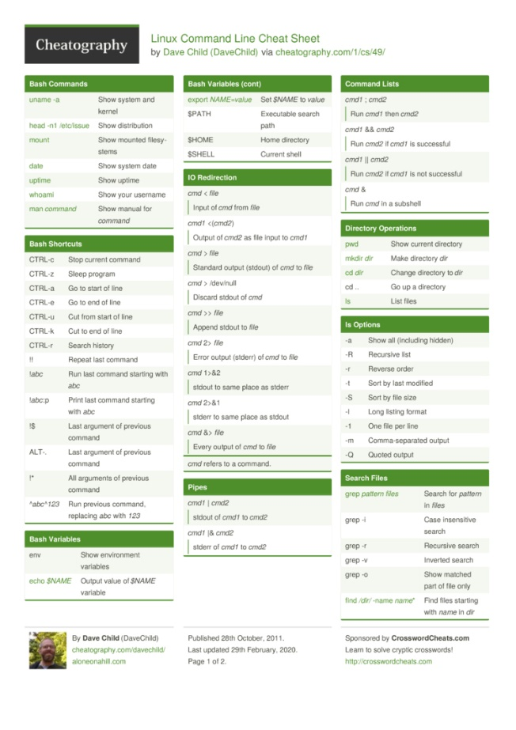
Linux + Ubuntu cheat sheet
https://cheatography.com/davechild/cheat-sheets/linux-command-line/
https://github.com/JREAM/ubuntu-cheatsheet

Slide 16

Ubuntu crash course: Windows Subsystem for Linux
Install Windows Terminal: https://www.microsoft.com/en-us/p/windows-terminal/9n0dx20hk701
Setting up WSL: https://docs.microsoft.com/en-us/windows/wsl/install
PowerShell command: wsl –install
Install notepad++ (VSCode also works): https://notepad-plus-plus.org/downloads/
Notes:
The Ubuntu shell is the main thing you’ll be working with → Bash → Way of interacting with your ‘computer’ (kernel) in a Pythonic way
If curious about Linux, dive into it, it’s awesome.

Slide 17
OpenFOAM
OpenFOAM: https://develop.openfoam.com/Development/openfoam/-/wikis/precompiled/debian
Paraview: https://www.paraview.org/download/

Slide 18
OpenFOAM programming
https://ash-caravan-0b9.notion.site/Setting-up-VSCode-for-OpenFOAM-debugging-in-Windows-77f4898aed5c4296b84d53eeb4ee4890
Required VSCode extensions:
Remote – WSL
C/C++
Required linux libraries:
gdb

Slide 19
Resources:

